Slide 1

f

Slide 2
Hours Worked Study
Hours Worked Study

Slide 3

Hours Worked Study
Hours Worked Study
Paola Estrada Contreras | DATA211 Final Project

Slide 4
Question:
Is there a significant statistical difference in the number of hours I am scheduled to work and the number of hours I actually work?

Slide 5
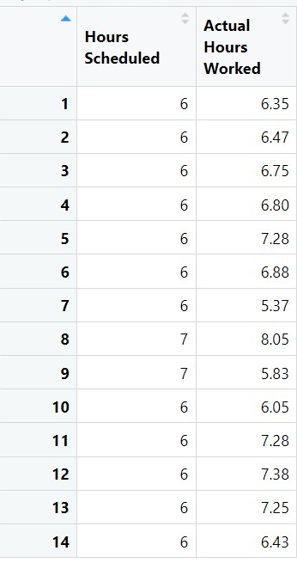
Data
14 observations
Variables
Hours Scheduled
Hours Worked

Slide 6
Hypothesis Testing
Claim:
The mean number of hours I work versus the amount of hours I am scheduled is significantly different
Step 1
Null Hypothesis
Alternative Hypothesis
Step 2
Use a T-test

Slide 7
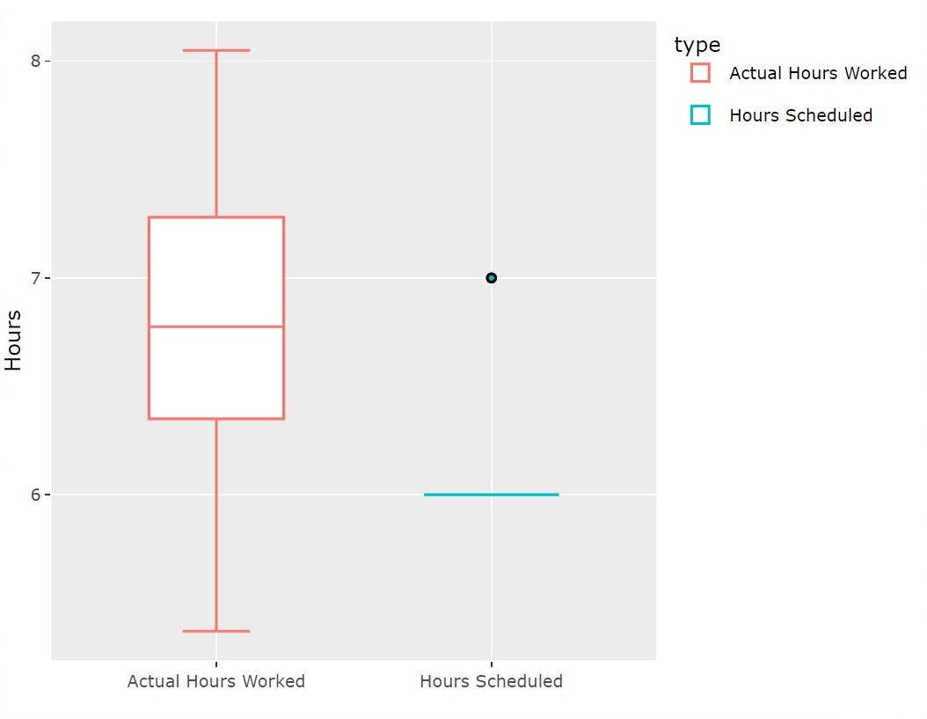
Hypothesis Testing
Step 3
Test Statistic
T= -2.9035
P-value: 0.01232
Step 4
Using a significance level of 0.05, I reject the null hypothesis

Slide 8
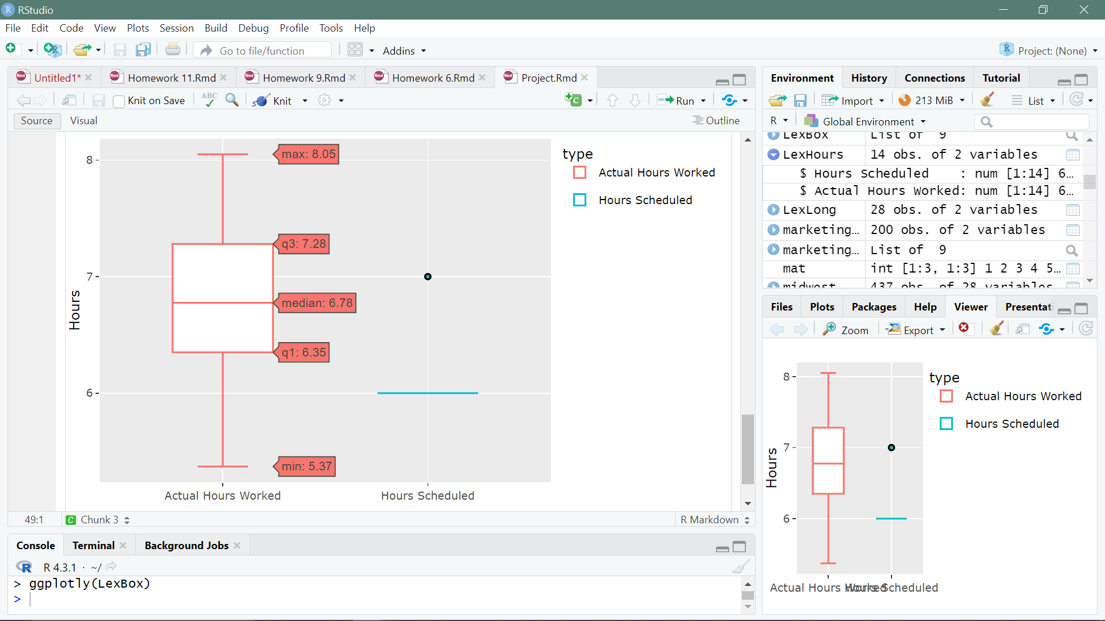

Slide 9
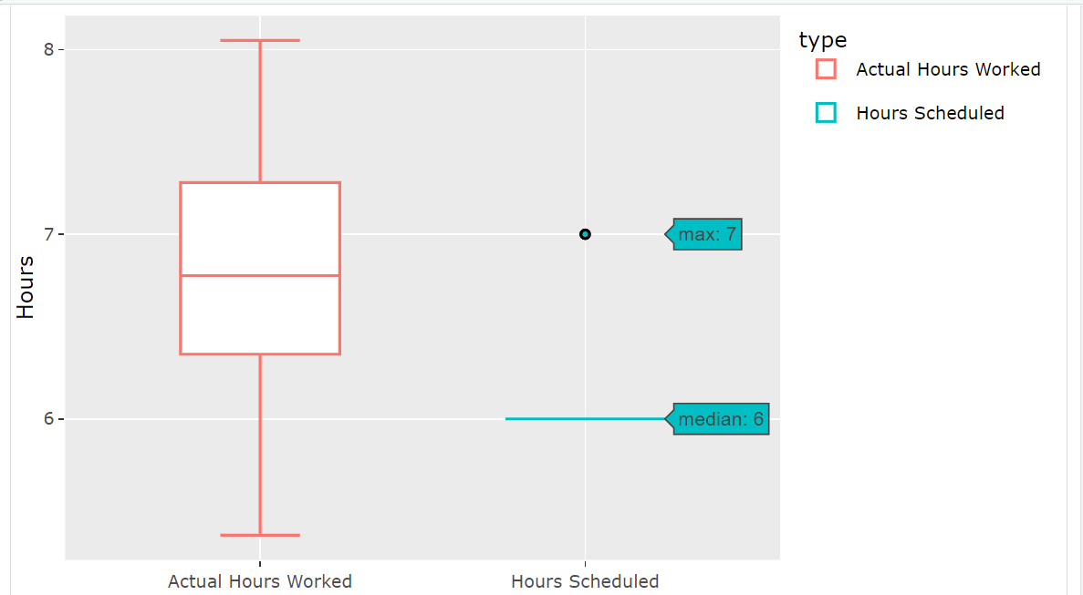
Graphs

Slide 10
Conclusion
Conclusion
At a 0.05 significance level, I reject the null hypothesis.
There is sufficient evidence to prove that the amount of time I am scheduled versus the amount of time I actually work is significantly different.

Slide 11

Conclusion
Conclusion
At a 0.05 significance level, I reject the null hypothesis.
There is sufficient evidence to prove that the amount of time I am scheduled versus the amount of time I actually work is significantly different.

